Slide 1


BESS Projects (SEN-Chile) v1.0 25/10/2023
Prepared for

Slide 2
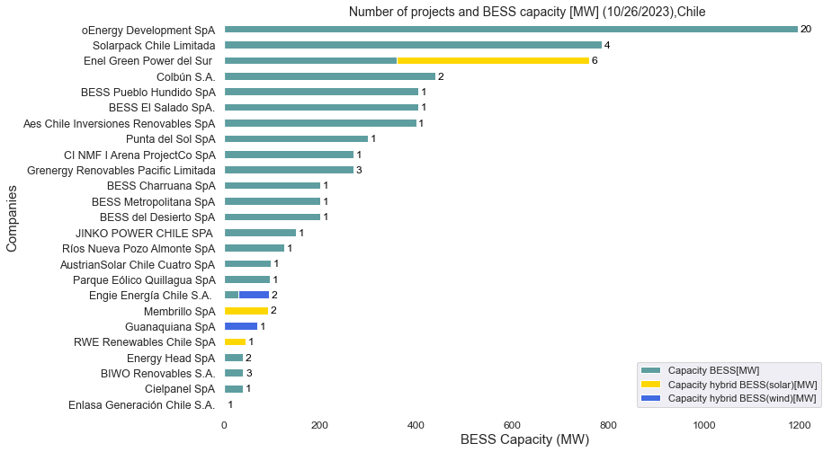
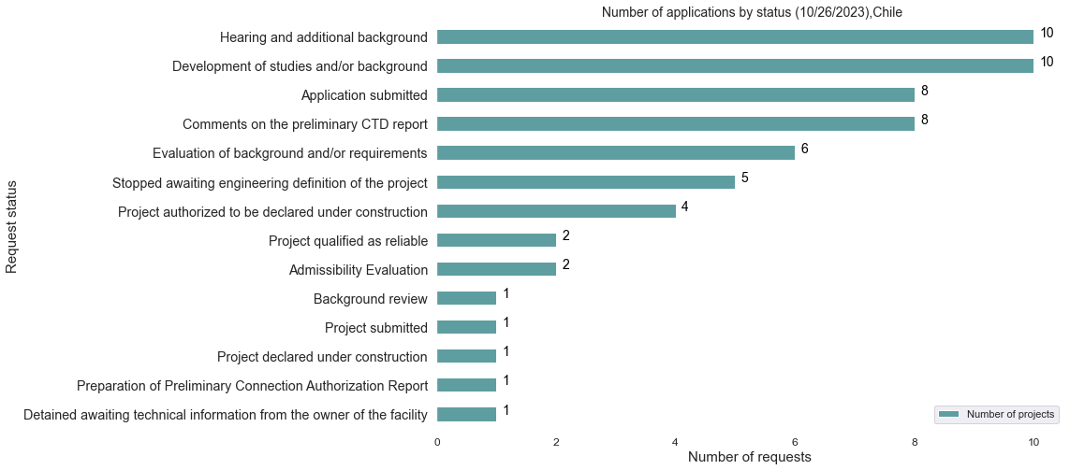
Summary of storage projects that have requested transmission access to the SEN
+60 Projects
+6720 [MW] capacity BESS
BESS projects application status
Filter criteria:
Type of project: Hybrid.
Rejected and unsuccessful applications are eliminated.
Only takes into account the BESS sources that declare capacity[MW].

Slide 3
Number of projects and capacity (MW)
Type of Project | Number of projects | Reported BESS Capacity (MW)
BESS Project | 52 | 6051
Hybrid project BESS+PV | 6(29)* | 536**
Hybrid project BESS+WIND | 2(7)* | 133**
All BESS projects | 60(88)* | 6720**
Not all hybrid projects (BESS+Solar/BESS+Wind) report BESS installed capacity.
Therefore:
()* Total BESS projects, including those that do not report installed capacity.
** Installed capacity of BESS taking into account only the projects that report their capacity.

Slide 4
Location, region and connection node
Region | Number of Project | Capacity (MW)
Antofagasta | 11 | 1793
Atacama | 15 | 1353
Tarapacá | 8 | 1219
Coquimbo | 6 | 653
Arica y Parinacota | 5 | 497
Biobio | 3 | 380
Metropolitana de Santiago | 3 | 300
Valparaíso | 4 | 333
Maule | 1 | 28
Libertador Bernardo O’Higgins | 3 | 144
Los Lagos | 1 | 20
Chile | 60 | 6720
SEN connection points with the highest number of connections
Region | Commune | Point of connection | Number of connection
Tarapacá | Pozo almonte | S/E Nueva Pozo Almonte 220 kV | 3
Atacama | Diego de Almagro | S/E Cumbre 220 kV | 2

Slide 5
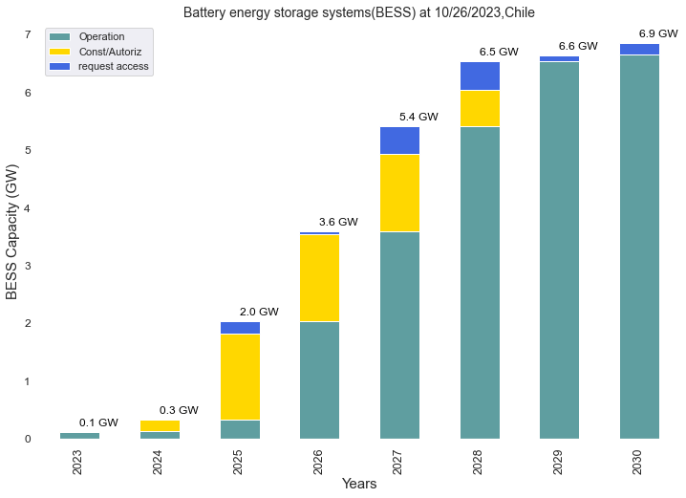

Projection of added capacity by 2030
3.5x
+60 proyects
3-6 hours (mean 4.58 H)
Includes operation of BESS AES ANDES2B (120 [MW])

Slide 6
Carlos Barría
carlos@gzecon.com

